Slide 1
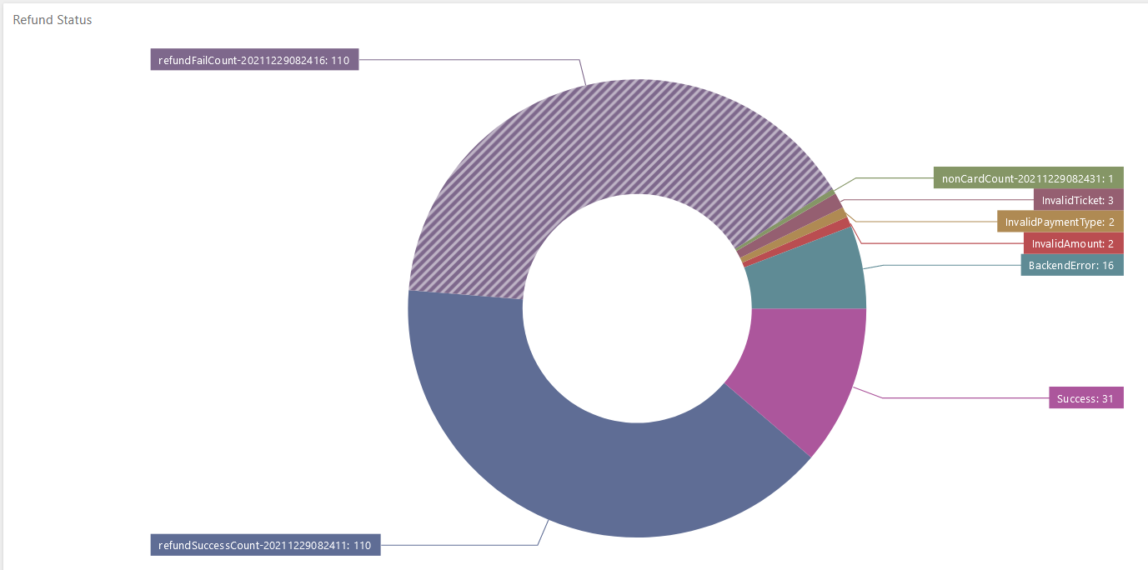
Creating
IBM RPA
Dashboards
with Counters

Slide 2
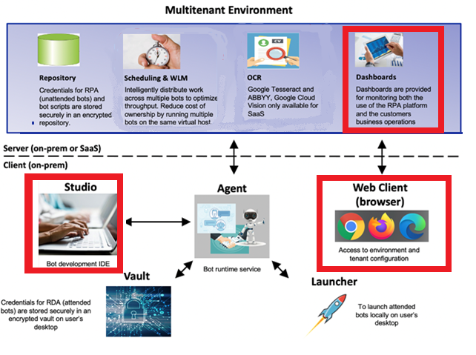
Creating
Dashboards
with Counters
Start by creating
counters in Bot code
Define a project
Define the counters
Create dashboard to display counters
2
IBM Automation / © 2022 IBM Corporation
2
Notes:
IBM, it’s clients and many industry participants see a clear path towards resiliency that leverages the most efficient and effective technologies for more agile, adaptive and resilient processes.
Automation enables customers to digitize their operations with low-code, cloud-ready containerized automation software.
Next, Automation applies AI in practical ways so you don’t need a data scientist. Things like, Document Understanding, Next Best Tasks. These build on your existing Digitization efforts with Cloud Pak for Automation.
Now you can offload work with our Digital Workers. Digital Workers without AI is just simple RPA/task automation.
We are in a crisis now but these are the things to do for long-term success, as well.

Slide 3
Difference between
Dashboards
and
Reports
It is important to distinguish between RPA Dashboards and RPA Reporting.
Reports are created from user data and viewed by customers.
Dashboards are viewed by administrators to resolve problems with bots.
The IBM RPA Dashboard can read data from three sources:
Jobs
Counters
Workflows and Processes
More detailed tutorial here:
https://learn.ibm.com/course/view.php?id=9051
IBM Automation / © 2022 IBM Corporation
3
Notes:
IBM, it’s clients and many industry participants see a clear path towards resiliency that leverages the most efficient and effective technologies for more agile, adaptive and resilient processes.
Automation enables customers to digitize their operations with low-code, cloud-ready containerized automation software.
Next, Automation applies AI in practical ways so you don’t need a data scientist. Things like, Document Understanding, Next Best Tasks. These build on your existing Digitization efforts with Cloud Pak for Automation.
Now you can offload work with our Digital Workers. Digital Workers without AI is just simple RPA/task automation.
We are in a crisis now but these are the things to do for long-term success, as well.

Slide 4
Lab 2
Dashboard Counters

Slide 6

Lab 2
Dashboards
with
Counters
Lab 2
Dashboards
with
Counters
IBM Automation / © 2022 IBM Corporation
6
Notes:
IBM, it’s clients and many industry participants see a clear path towards resiliency that leverages the most efficient and effective technologies for more agile, adaptive and resilient processes.
Automation enables customers to digitize their operations with low-code, cloud-ready containerized automation software.
Next, Automation applies AI in practical ways so you don’t need a data scientist. Things like, Document Understanding, Next Best Tasks. These build on your existing Digitization efforts with Cloud Pak for Automation.
Now you can offload work with our Digital Workers. Digital Workers without AI is just simple RPA/task automation.
We are in a crisis now but these are the things to do for long-term success, as well.

